Slide 1
Mid-term Electricity Demand Forecasting
STAT-S650
Spring 2020
Arunav Saikia
M.S. Data Science (Residential)
arsaikia@iu.edu

Slide 2
Objective
Electricity demand forecasting is an essential tool for energy management, maintenance scheduling and investment decisions in the energy markets.
Electricity demand for a region depends on economic variables – oil prices, stock prices, exchange rates; demographic circumstances – holidays, population and most importantly climatic conditions – temperatures, humidity etc.
In this project we want to measure how daily temperatures affect electricity demand for a region. We will also investigate how accurately temperature can be use to forecast the demand in mid-term (8 weeks/2 months)
Data
The data is for operational electricity demand for Victoria, Australia. Operational demand is the demand met by local scheduled generating units, semi-scheduled generating units, and non-scheduled intermittent generating units of aggregate capacity larger than 30 MW, and by generation imports to the region.
There are 2 measures –
The data has 365 timepoints for each day in the year 2014
‘Demand’ is the criterion of interest and ‘Temperature’ is the predictor variable.
Demand: | Total electricity demand in GW for Victoria, Australia, every day during 2014.
Temperature: | maximum daily temperatures for Melbourne

Slide 3
Data Analysis – Time Domain and Frequency Domain
Since both series have a quadratic trend and cyclic components we will de-trend both series using regression and then investigate the noise (residuals) using auto-correlation and spectral analysis
Fig. 1 - Daily Demand and Max Temperatures for 365 days in 2014
We can see that both 'Demand' and 'Temperature' have systematic cycles. For Demand we have spikes at f1 = .1428571 and f2 = .2857143 denoting some periodicity every 7 days and 3.5 days respectively; and for Temperature at f3 = .1706667 denoting some periodicity every 6 days. So we will try to remove these using regression by fitting sinusoids at these frequencies.
Fig. 2 - Periodogram for each measure

Slide 4
Data Analysis – Autocorrelation and Spectral Density
Demand
Temperature
Here we have the autocorrelation of residuals for both measures after de-trending. We used order 6 and 4 polynomials to trend demand and temperature resp. Further we used sinusoids to remove the systematic cycles. It looks like Demand is an AR(2) process while Temperature is MA(1) process
Fig. 3 - Autocorrelation of residuals for each measure after de-trending using regression
The spectral density for Temperature has a cosine shape which means it is MA processes. Although spectral density for Demand has a cosine shape, we saw above that it is an AR process. Therefore, Demand is probably an ARMA process
Fig. 4 - Spectral Density of residuals for each measure

Slide 5
Data Analysis – Cross Correlation and Coherence
From the cross-correlation plot we can say both series are leading each other at lag of 1. Also from the squared coherence there seems to be some correlation between the 2 series at f = .17 and f = .32 although the correlation is not that high
Fig. 5 – Cross-correlation and cross-spectral analysis for each measure after de-trending using regression

Slide 6
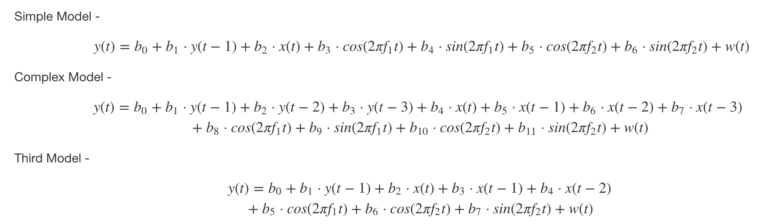
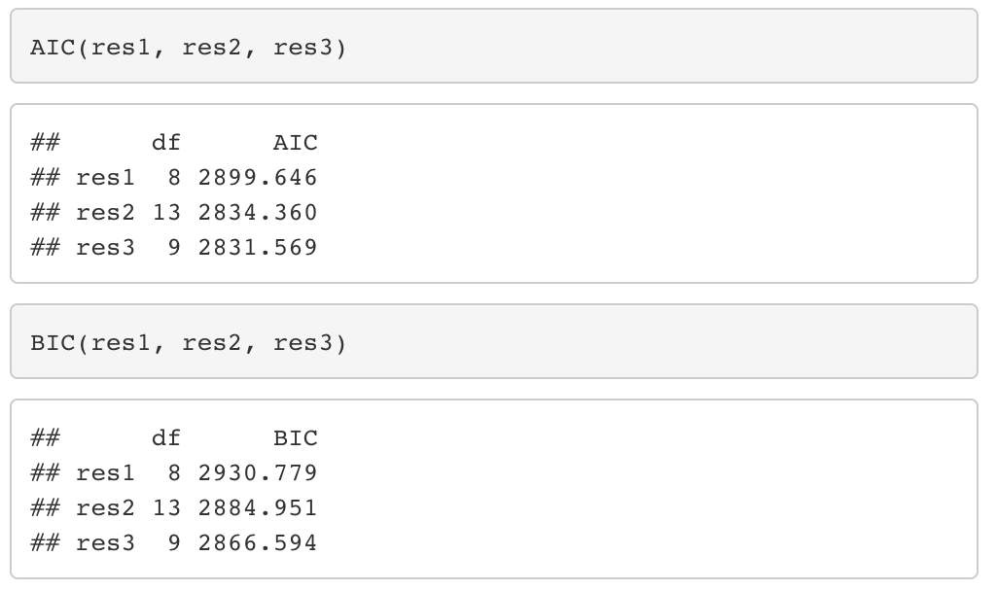
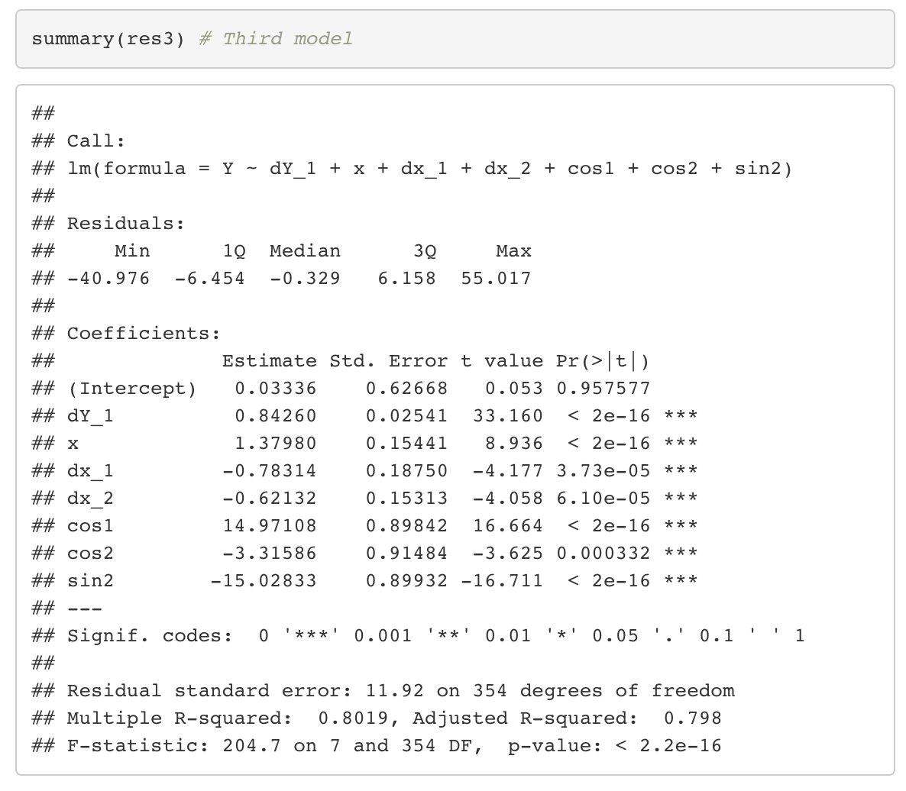
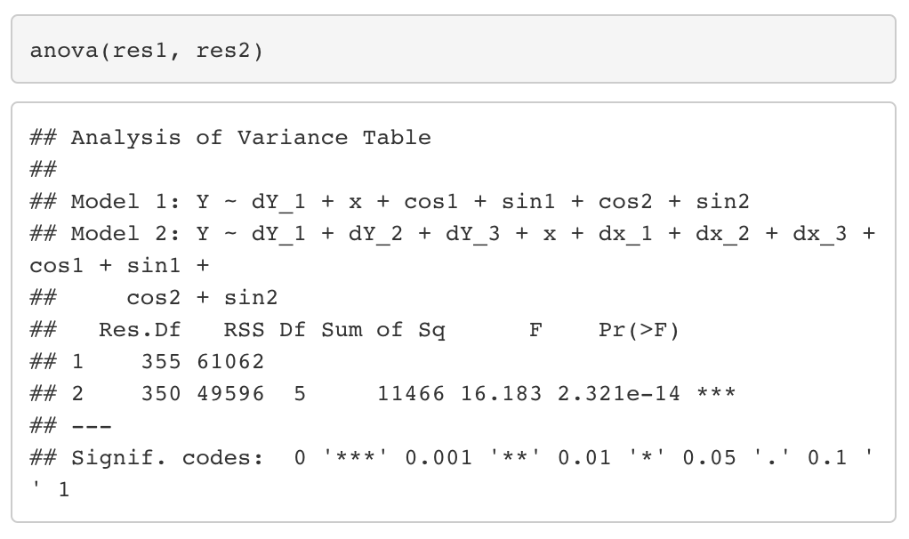
Model Estimation and Comparison – Linear Difference Eq. with white noise
Here we have 3 competing difference equation models. The simple model is nested within the complex model and the third model is not nested. y(t) is the criterion and x(t) is the predictor. w(t) is white noise. f₁, f₂ are frequencies where y(t) shows systematic cycles in the periodogram.
By looking at the F-test we see that we get a p-value < 0.01 significance level, which means we can reject the Null hypothesis and both models (simple vs. complex) are not same. By looking at the AIC/BIC we can see that the Third Model with an adjusted R² = 0.798 is best as it has lowest AIC and BIC scores

Slide 7
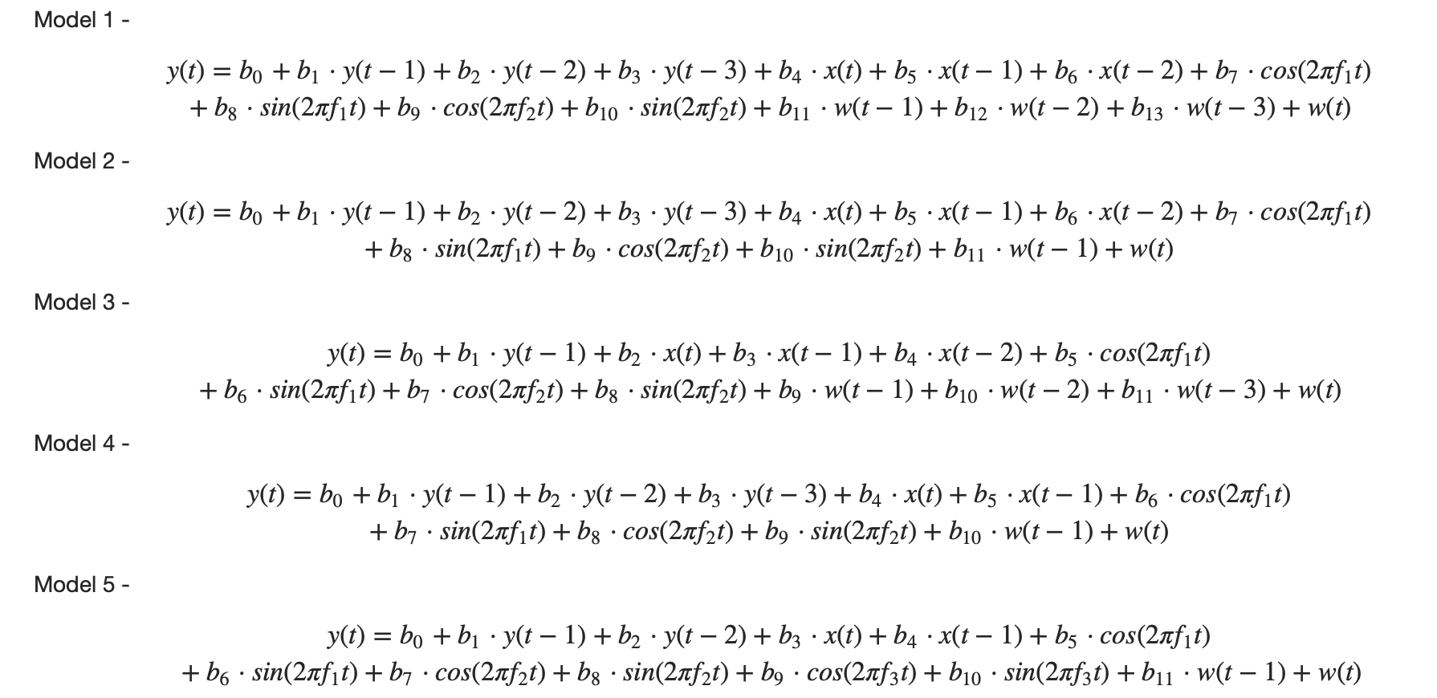
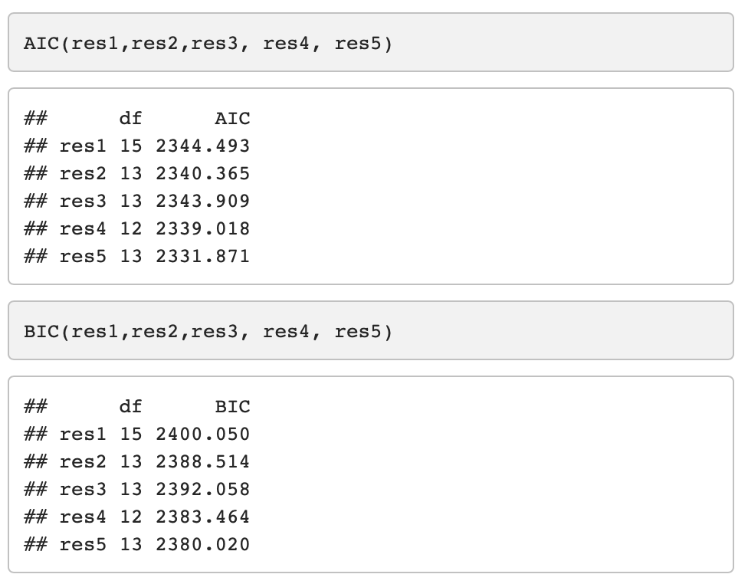
Model Estimation and Comparison – ARMAX
Fig. 6 – Spectral analysis on the residuals from ’Third Model’
Here we have 5 competing ARMAX models of varying complexity in terms of autoregressive and moving average components. y(t) is the criterion and x(t) is the predictor. w(t) is white noise. f₁, f₂ are frequencies where y(t) shows systematic cycles in the periodogram (Fig. 2).
When we looked at the periodogram of the residuals from the previous best model i.e. Third Model, we saw there was a spike around f = .429333333 , so we added sinusoids at f₃ to take care of this in our ARMAX models
Since the models are not nested we can use AIC and BIC to compare and choose the best model. We can see Model 5 has lowest AIC and BIC scores, and therefore is our champion model.

Slide 8
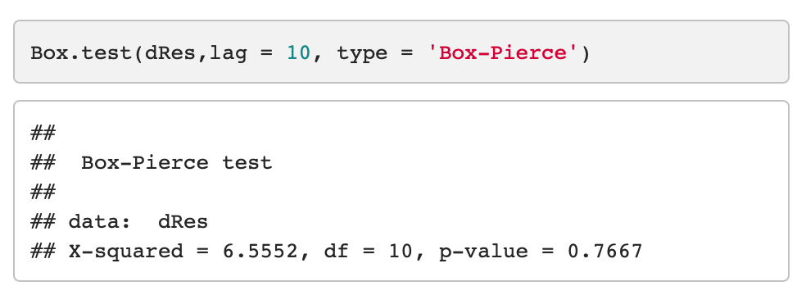
Residual Analysis – Champion Model
The residuals are centered around zero and variance looks constant. The auto-correlation plot also does not show correlation at different lag components.
Fig. 7 – Variance and autocorrelation of the residuals after fitting champion model
From Box-Pierce test we can say that there is no significant evidence of auto-correlation up to lag 10 components. The periodogram looks flat with no significant peaks suggesting no autocovariance at different frequencies. Thus the residuals are white noise.
Fig. 8 – Result of Box-Pierce Test and spectral analysis on the residuals

Slide 9
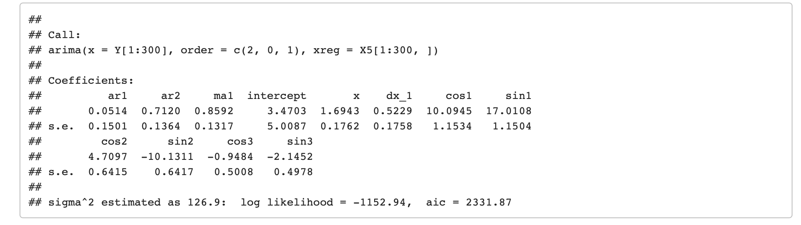
Interpretation and Forecast – Champion Model
Model Comparison – ARMAX
The model has order 2 feedback terms and order 1 noise component. The AR(2) term and MA(1) term are significant and positive. AR(1) is insignificant as 95% confidence interval of the coefficient estimates will include 0. The model also has exogenous inputs which drive the mean of the output. There are sinusoids which capture cyclic/seasonal trends. Almost all sinusoids are statistically significant except cos3. x(t) and x(t−1) capture the effect of systematic input i.e temperature on the output. Since the coefficients are positive it means there is a positive correlation between temperature and electricity demand
Fig. 9 – Coeff. and std errors of estimates for the champion ARMAX(2, 0, 1) model
Since our goal was to see how well the model can be used for forecasting, we used the first 300 datapoints for estimating the model parameters and latter 65 datapoints ~ 8 weeks/2 months for forecasting. We can see the model estimates the observed data very closely.
Fig. 10 – On the left we have the observed data and fitted values from the champion model. On the right we have the observed and predicted values on hold out data.

